Slide 1

TIC-TAC-TOE:A GAME IN C
Code Breakdown & Explanation

Slide 2
Team Members
Name: Ajwad Md. Ajimuddin Hossain
ID: 2421325042
Name: Mohammad Alfee Mahtin
ID: 2423804642

Slide 3


Purpose of the Program :
This is a text-based Tic Tac Toe game written in C. Two players take turns selecting positions on a 3x3 board to place their symbol ('X' or 'O'). The game ends when one player gets three symbols in a row (horizontally, vertically, or diagonally) or the board is full (a draw).

Slide 4

1.Global Variables
It represents the nine positions on the board:
c1 | c2 | c3
----+----+----
c4 | c5 | c6
----+----+----
c7 | c8 | c9
Each position can hold 'X', 'O', or ' ' (a space indicating it’s empty).
Declared globally so they can be accessed and modified by multiple functions.

Slide 5
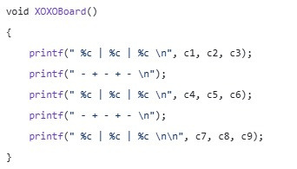
WHO WE ARE
2.Displaying the Board: XOXOBoard()
Purpose: Displays the current state of the game board in a clean, formatted way.
Each %c is replaced by the value of the corresponding c1, c2, ..., c9.

Slide 6
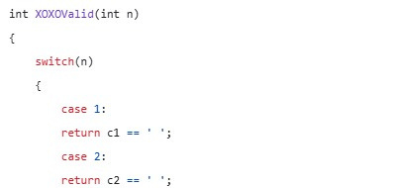
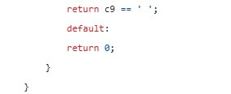
4.Validating Moves: XOXOValid(int n)
Purpose: Ensures the chosen position (n) is valid.
How it works:
n corresponds to positions 1–9.
If the position contains ' ', it is empty, and the move is valid (return character).
Otherwise, the move is invalid (return 0).

Slide 7
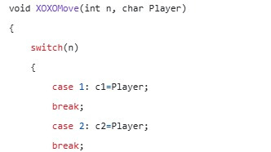
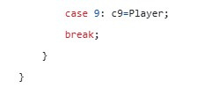
5.Making a Move: XOXOMove(int n, char Player)
Purpose: Places the current player's symbol ('X' or 'O') in the specified position (n).
The value of the corresponding global variable (c1 to c9) is updated.

Slide 8
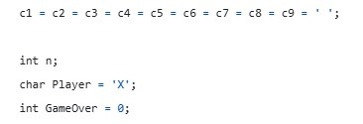
6.Main Function: Game Initialization and Logic
Initial Setup
All board positions are set to ' ' (empty).
The starting player is 'X'.
The GameOver flag tracks whether the game has ended (0 = ongoing, 1 = over).

Slide 9
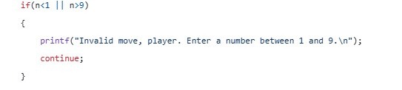
7.Input Validation: Range Check
Ensures the input n is within the valid range (1 to 9).
If invalid, displays an error message and skips to the next iteration of the loop using continue.

Slide 10
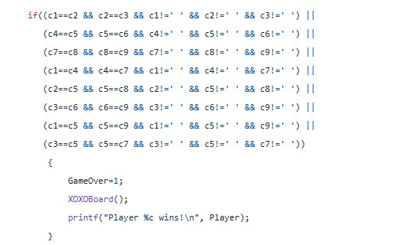
8.Checking For A Win
Checks all possible winning combinations:
Rows: (c1, c2, c3), (c4, c5, c6), (c7, c8, c9)
Columns: (c1, c4, c7), (c2, c5, c8), (c3, c6, c9)
Diagonals: (c1, c5, c9), (c3, c5, c7)
Ensures all three positions in a combination match and are not empty (' ').
If a player wins:
Sets GameOver = 1 to end the loop.
Displays the updated board and a winning message.

Slide 11
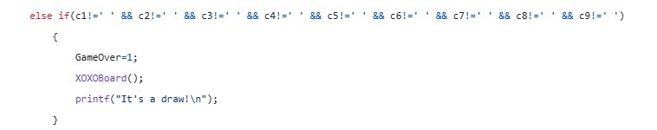
9.Checking for a Draw
Checks if all positions on the board are filled without a winner.
If true:
Sets GameOver = 1.
Displays the board and prints "It's a draw!".

Slide 12
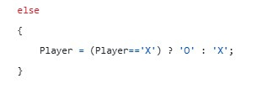

10.Switching Players
11.Invalid Move Message
If no win or draw, switches the current player:
If Player == 'X', sets it to 'O'.
If Player == 'O', sets it to 'X'.
If the position n is not empty, notifies the player and lets them try again.
Once GameOver is set to 1, the loop ends, and the program terminates with a successful return code.

Slide 13
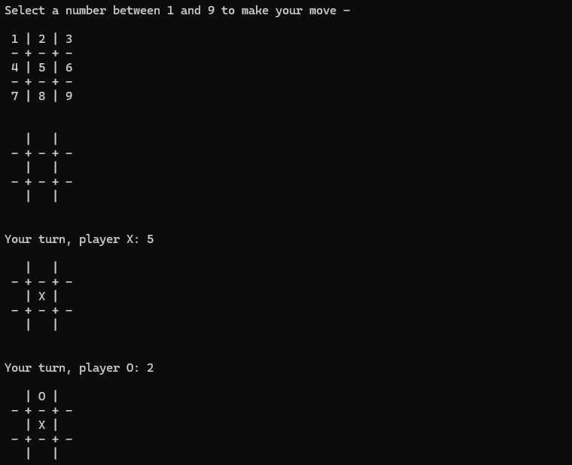
12.An Example Gameplay
Continues until a win or draw.

Slide 14
THANK YOU!
For being with us!!

